Slide 1

Progress Report
Animal Image Recognition
IST 707 Applied Machine Learning
Kangsheng Pu

Slide 2
Quick Overview
terminologies and packages
Challenges and its approaches
Future plans
Agenda

Slide 3
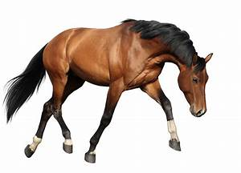
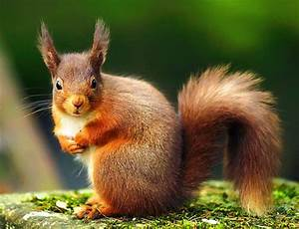

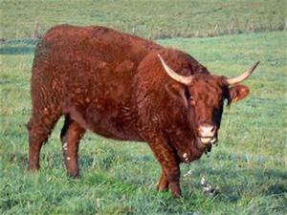
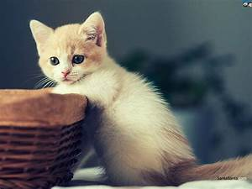
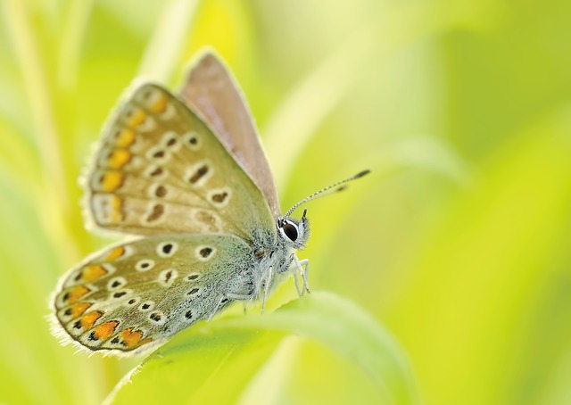
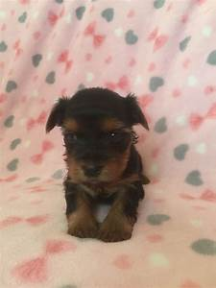
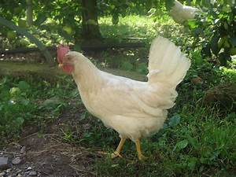
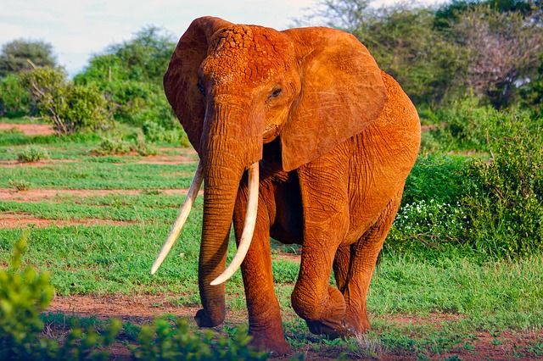
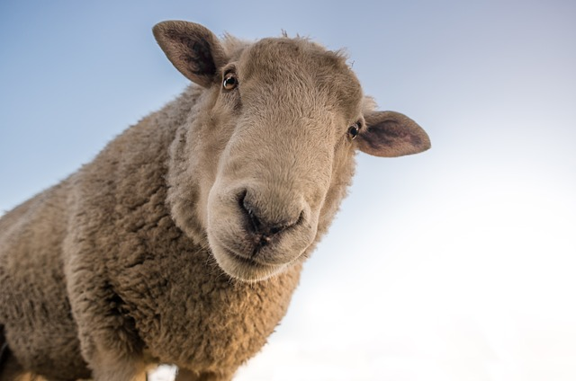
Quick Overview:
Kaggle: https://www.kaggle.com/datasets/alessiocorrado99/animals10/code
Raw image data for ten categories of animals:
Cow, cat, butterfly, dog, roster, elephant, sheep, spider, squirrel, horse
26179 Images.

Slide 4
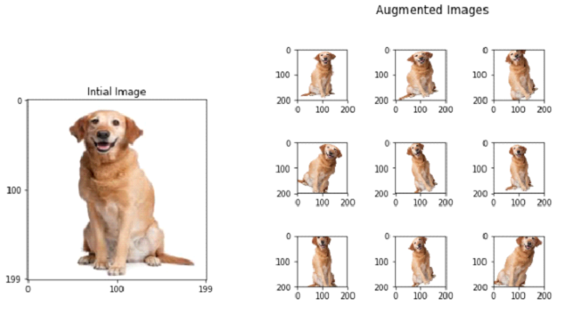
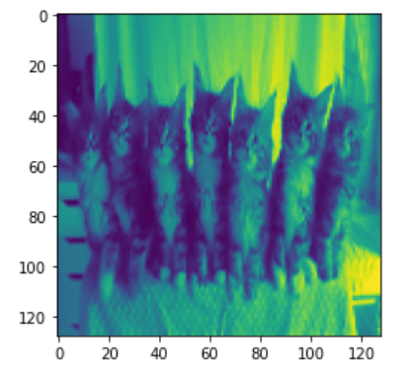
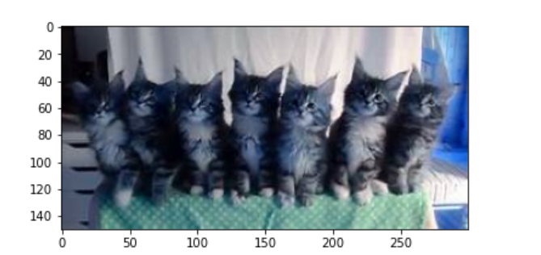
Terminologies and Packages
TensorFlow
Image distortion and augumented images for sampling
Rotation
Shear
Horizontal/Vertical coordinate flip
Zoom
Image distortion parameter tuning
GrayShade transformation

Slide 5
Challenges
Image too large to process
Solution: decrease resolution from 224*224 to 128*128
Naïve Bayes Classifier did not accept Matrix input
Reason: Found array with dim 3. Estimator expected <= 2
Question: The X dataset is a dimension
[128*128 * numberOfImages] while the model refuses to accept.
Original Approach: transfer all matrices to dataframe and train the model
Separate the dataset into 26 batches and run separately in two laptops.
Restrictions: waste extra time.

Slide 6
Future tasks
Feed the model to multiple algorithms that have mentioned previously:
Naïve Bayes Classifier
Support Vector Machine
Convoluted Neural Network
Random Forest
Might decrease the units image number to train the models.

